Slide 1
Interpretation of scope ambiguity in English by English native speakers and Chinese bilingual speakers
LT 3211 Semantics
Group memebers:
KWAN Ka Lai, Lily (54045601)
LI Mengchen, May (54779196)
Wong Po Ying, Freda (54053533)
WAN Yuwei, Mia (54382027)

Slide 2
Agenda
Introduction & literature review (KWAN)
Hypothesis & Aim (KWAN)
Methodology (WONG)
Results analysis (WAN)
Discussion & Conclusion (LI)

Slide 3
Introduction & Literature Review
Scope Ambiguity
an ambiguous sentence with two scopal expressions (Kearns, 2011)
with both scopes representing possible interpretations of the sentence
not the ambiguity for a single word but affected by other elements such as qualification and negation (Flax, 2018)
SAME surface structure
DIFFERENT deep structure

Slide 4
Introduction & Literature Review
Scope Ambiguity (Cont’d)
Logico-semantic level (Kurtzman & MacDonald, 1993)
Quantifier scope
If every / some / a / many / a few / appears more than or equal to two in determiner position
Scope ambiguity may occur
One sentence with two different logical structures with different relative scope

Slide 5
Introduction & Literature Review
EO
OE
Every
One
One
Every
>
>

Slide 6
Every shark attacked a pirate.
(Scontras, Tsai, Mai & Polinsky, 2014)
Surface scope (EO)
Inverse scope (OE)
“for every shark, there is a (potentially different) pirate that it attacked.” (Scontras et al., 2014)
“there is one pirate that every shark attacked.” (Scontras et al., 2014)
EO: Logical Form (scope relation)
OE: An inversion of the scope of subject and object quantifiers

Slide 7
A shark attacked every pirate
(Scontras, Tsai, Mai & Polinsky, 2014)
Surface scope (OE)
Inverse scope (EO)
“There is one shark that attacked every pirate” (Scontras et al., 2014)
“For every pirate, there is a (potentially different) shark that attacked him” (Scontras et al., 2014)
OE: An inversion of the scope of subject and object quantifiers
EO: Logical Form (scope relation)

Slide 8
Every shark attacked a pirate.
A shark attacked every pirate
Similar ambiguity
A change in the linear order of the quantifiers

Slide 9
Hypothesis
1.
Chinese
English (English native speakers)
small scope ambiguity
Inverse version will be much lower than surface version in both EO and OE
big scope ambiguity
two versions in EO and OE will all be high

Slide 10
2.
Passive structure will not change understanding of native English speakers, but it will enlarge the scope ambiguity in both Chinese and English of native Chinese speakers
3.
English of native Chinese speakers will not be same as that of native English speakers, it will be relatively same as their native language——Chinese.

Slide 11
Aim
1.
Find resolution on ambiguity (Kurtzman & MacDonald, 1993) - we interpret the meaning of a give sentence unconsiously and very fast
2.
Avoid misunderstanding of an utterance from a native English speaker by bilingual Chinese speakers
eg. Every fish was caught by a shark. Chinese speaker: There is a shark who caught all the fishes. English speaker: For each fish, it was caught by one individual shark.

Slide 12
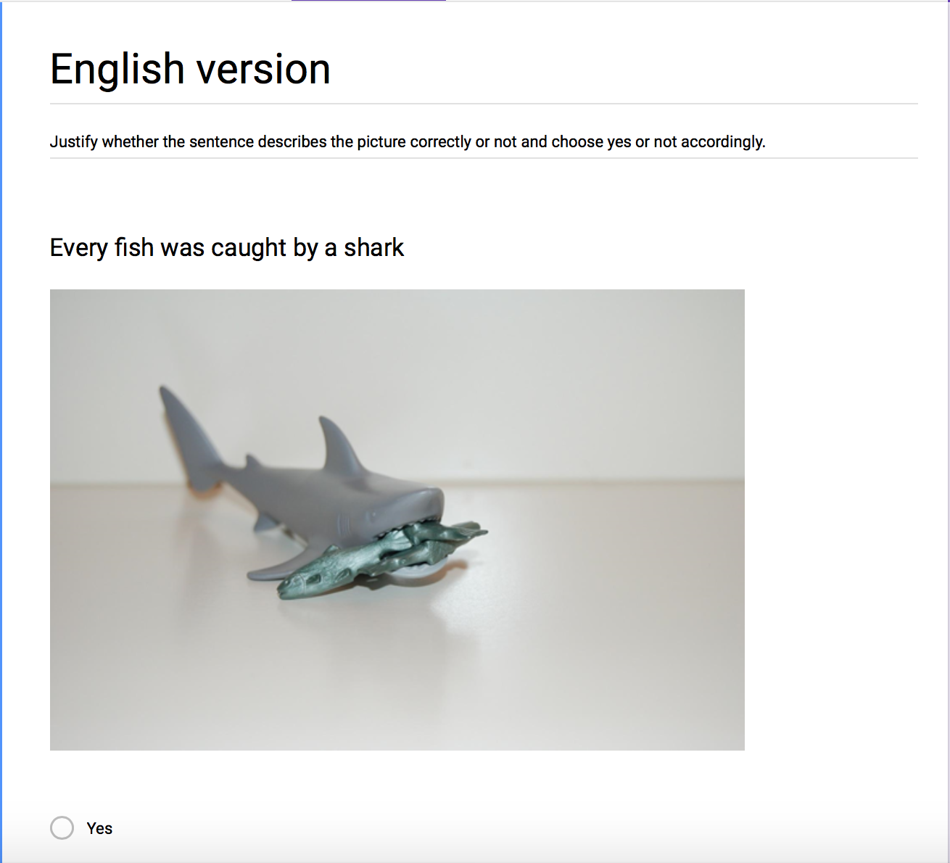
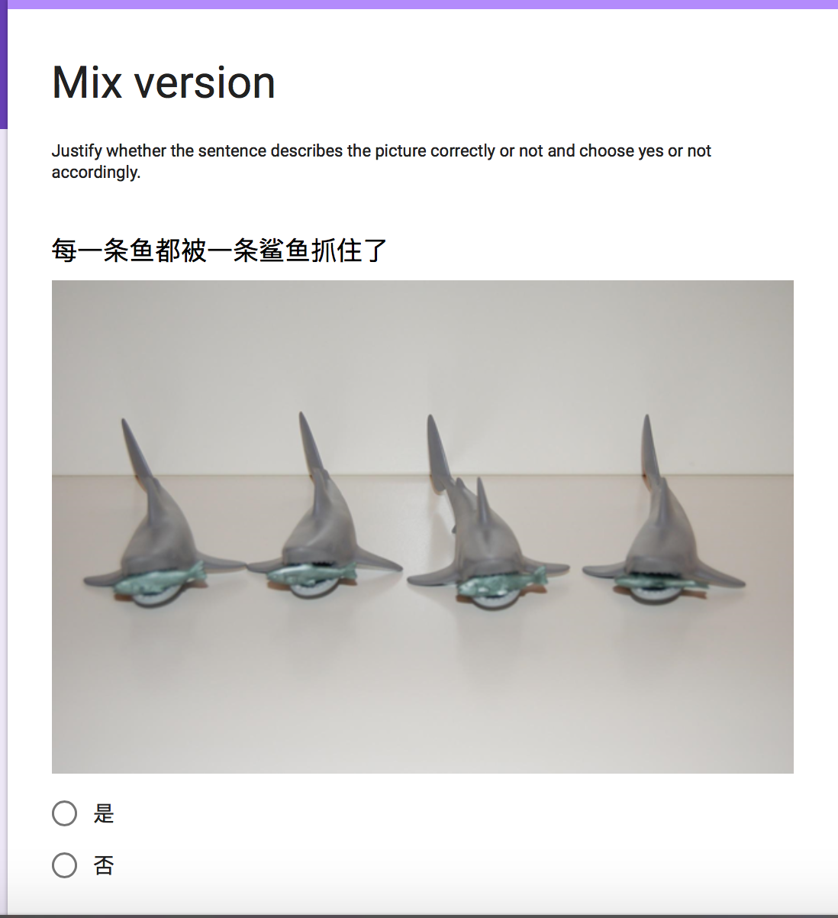
Methodology
In this study, we set up TWO sets of survey :
For English Native Speaker - 8 participants
For Bilingual speaker (Native Mandarin, English Bilingual)
- 34 participants
Notes:
We survey native English speakers to see the level they can understand both of meaning
[19:50, 4/11/2018] +852 5373 2474: We survey bilingual Chinese people to see whether they can realize inverse meaning, If not, whether It will influence their understanding of inverse meaning in English
[19:51, 4/11/2018] +852 5373 2474: So one pure English survey is for 8 native English speakera and one mix language survey is for 32 bilingual speakers
[19:52, 4/11/2018] +852 5373 2474: both of the survey are ready for use after asking Edwin about some setting problem

Slide 13
Methodology - Participants’ profile
 | Age | Education | English level | Nationality | Native Language
Native English Speaker | 20 - 26 | Bachelors degree | Native | 5 from U.S. 3 from Canada | English
Bilingual Speaker | 20 - 26 | Bachelors degree in English Speaking University | Ielts 6.0 or above | 34 Chinese (Mainland) | Mandarin
Similar age range

Slide 14
Methodology - Participants’ profile
 | Age | Education | English level | Nationality | Native Language
Native English Speaker | 20 - 26 | Bachelors degree | Native | 5 from U.S. 3 from Canada | English
Bilingual Speaker | 20 - 26 | Bachelors degree in English Speaking University | Ielts 6.0 or above | 34 Chinese (Mainland) | Mandarin
Similar age range
Bilingual Speakers University level education & Ielts 6.0 or above - Similar exposure to foreign language

Slide 15
Methodology - Participants’ profile
 | Age | Education | English level | Nationality | Native Language
Native English Speaker | 20 - 26 | Bachelors degree | Native | 5 from U.S. 3 from Canada | English
Bilingual Speaker | 20 - 26 | Bachelors degree in English Speaking University | Ielts 6.0 or above | 34 Chinese (Mainland) | Mandarin
Similar age range
Bilingual Speakers University level education & Ielts 6.0 or above - Similar exposure to foreign language
Only Mainland mandarin native speakers are chosen → Make sure similar Chinese language exposure (mainly Mandarin) → Cantonese and other dialect might have different cultural interpretation to scope ambiguity

Slide 16
Methodology
Time Frame : 10th April 2018 - 17th April 2018 Setting : Native English Speaker → 22 Question , All English Bilingual English Speaker → 44 Questions, 23 Chinese, 21 English Procedure - Interview were conducted in two forms 1. Face to face 2. Online Survey 1. Face to face : We show the participants the survey on our computer and they do it themselves Participants were observed for their a. Speed to reach decision and b. Hesitation 2. Online survey : Each Participant receives a link to the survey Participants were interviewed after the survey if they have a. Hesitation b. Difficulties in reaching decision c. Awareness of scope ambiguity

Slide 17
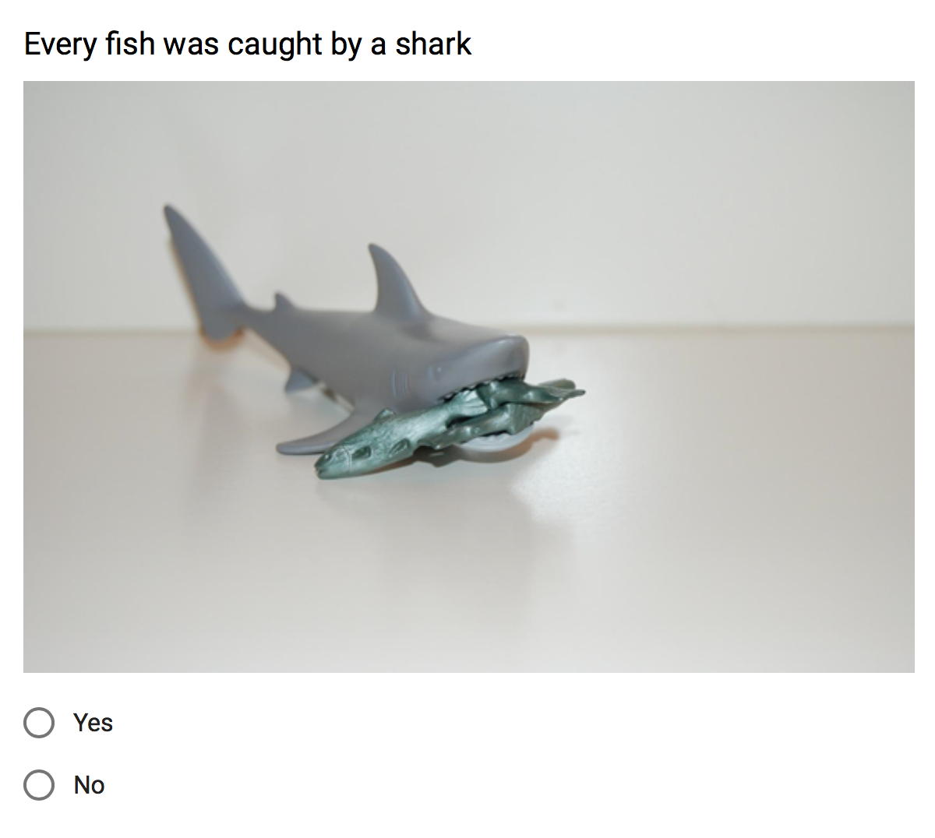
Methodology
Survey design :
Participant see the statement with ambiguous/ no ambiguous meaning
See the photo of one of the interpretation (Surface/ Inverse) of the statement
Only choice of “Yes” and “No” is given
1
2
3

Slide 18
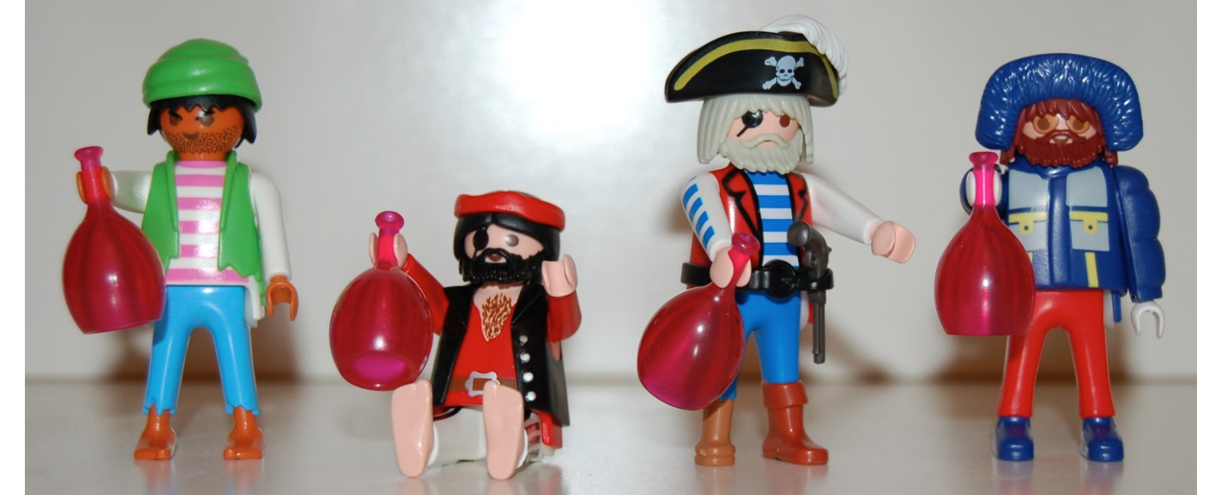
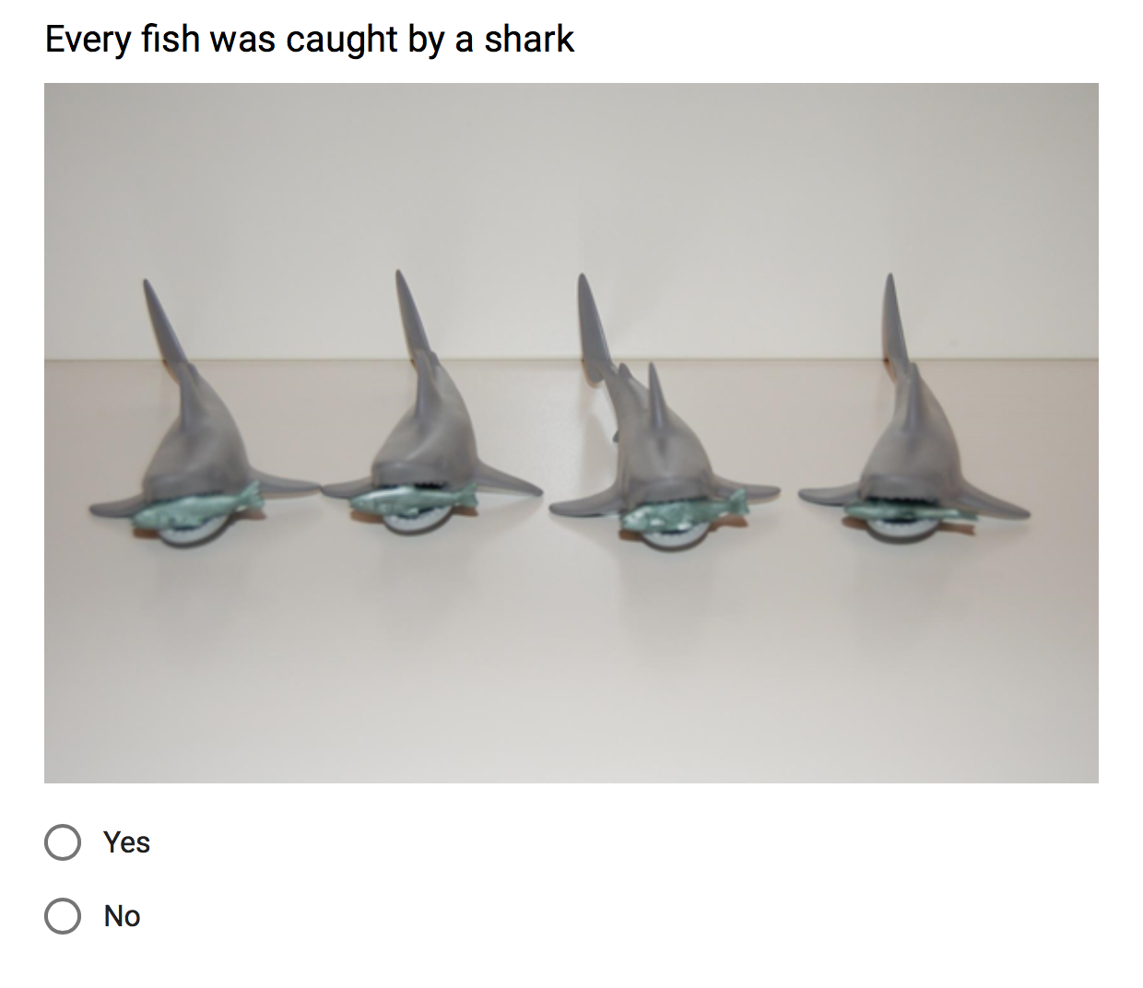
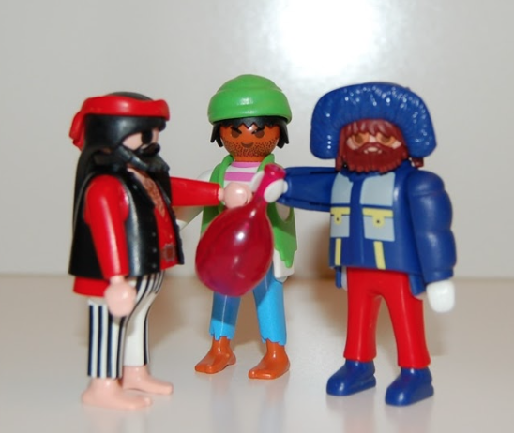
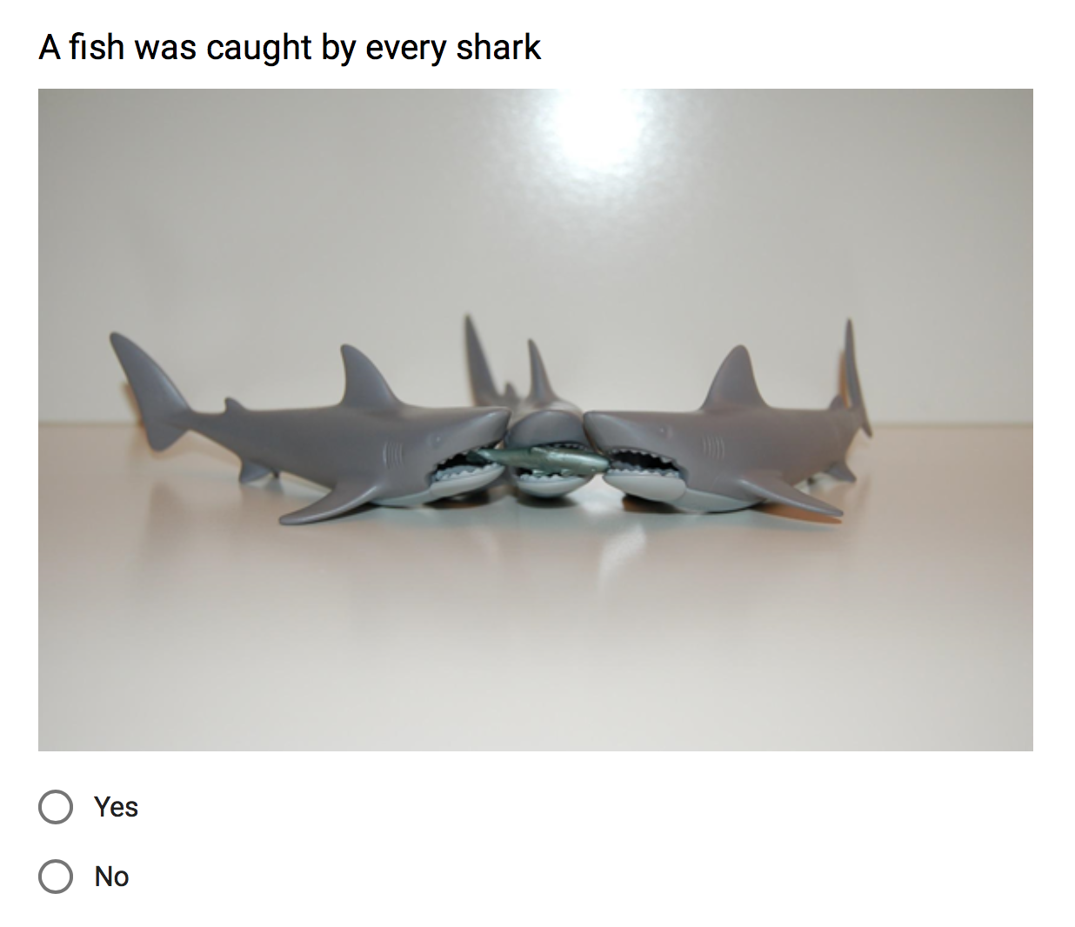
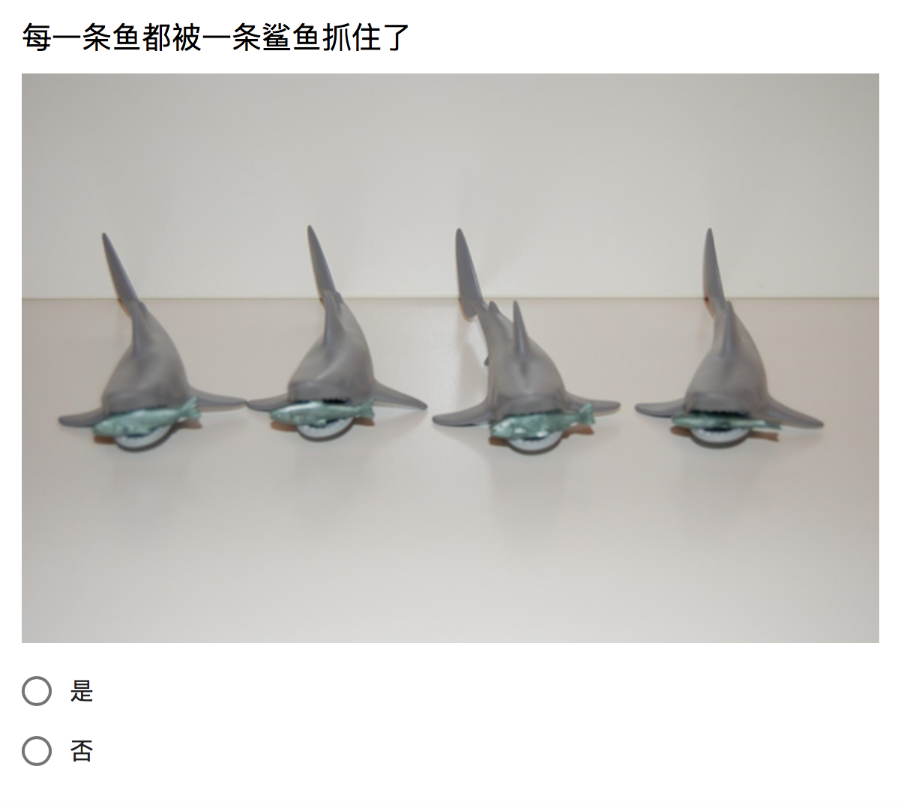
Methodology
Three types of statement are provided in the survey - Inverse Meaning
Every > One (Active) : A pirate hold every bottle
Every > One (Passive) : Every fish was caught by a shark
EO
One > Every (Active) : Every Pirate held a bottle
One > Every (Passive) : A fish was caught by every shark
OE

Slide 19
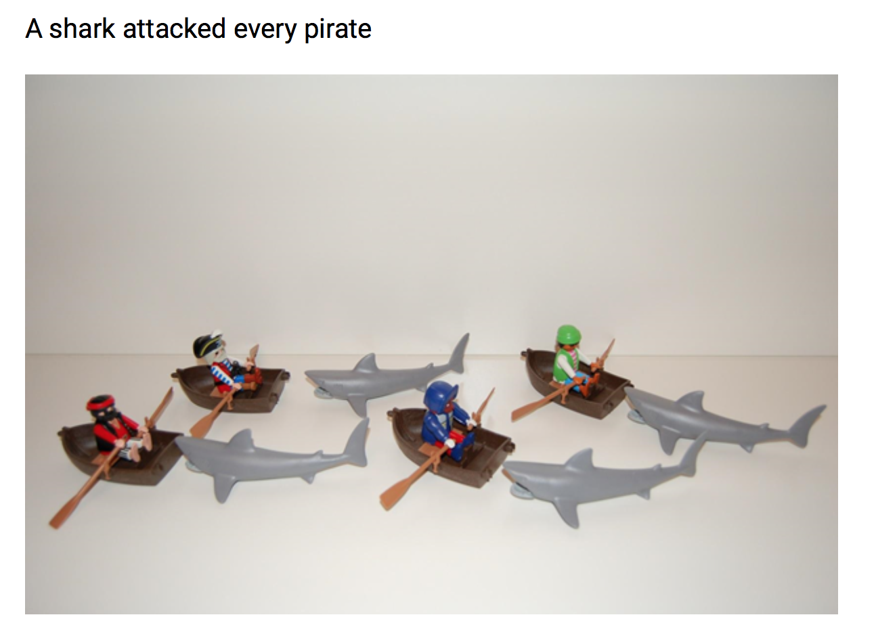

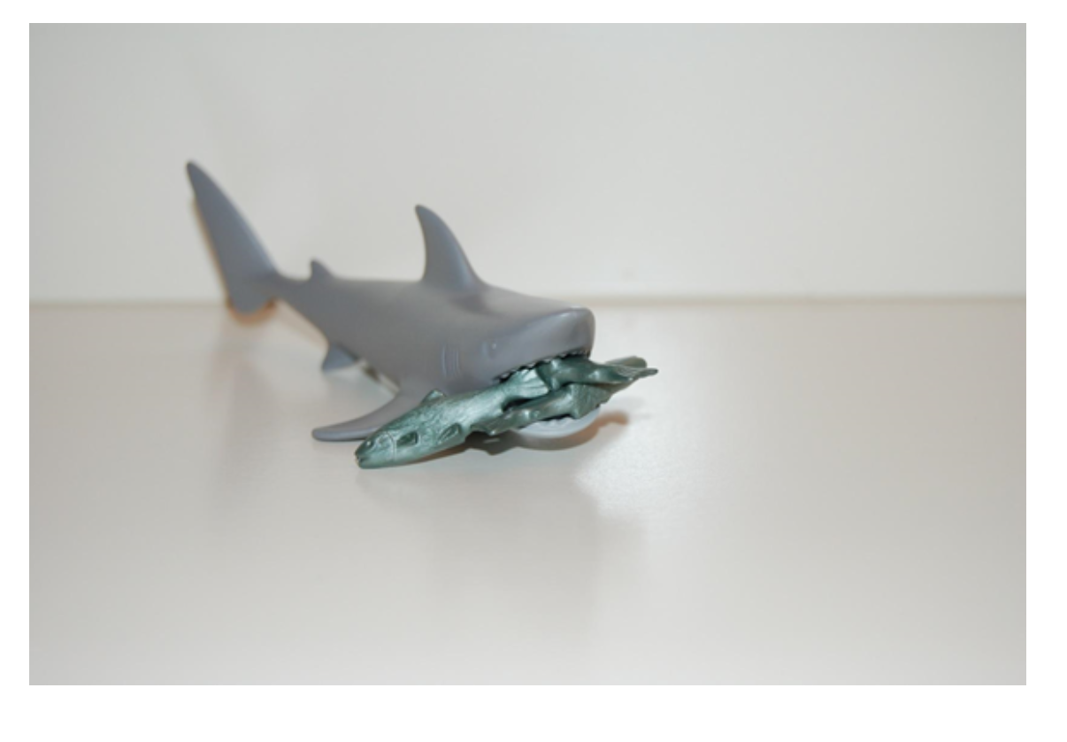
Methodology
Three types of statement are provided in the survey - Surface meaning
Every > One (Active) : Every pirate held a bottle
Every > One (Passive) : A fish was caught by every shark
EO
One > Every (Active) : A pirate held every bottle
One > Every (Passive) : Every fish was caught by a shark
OE

Slide 20
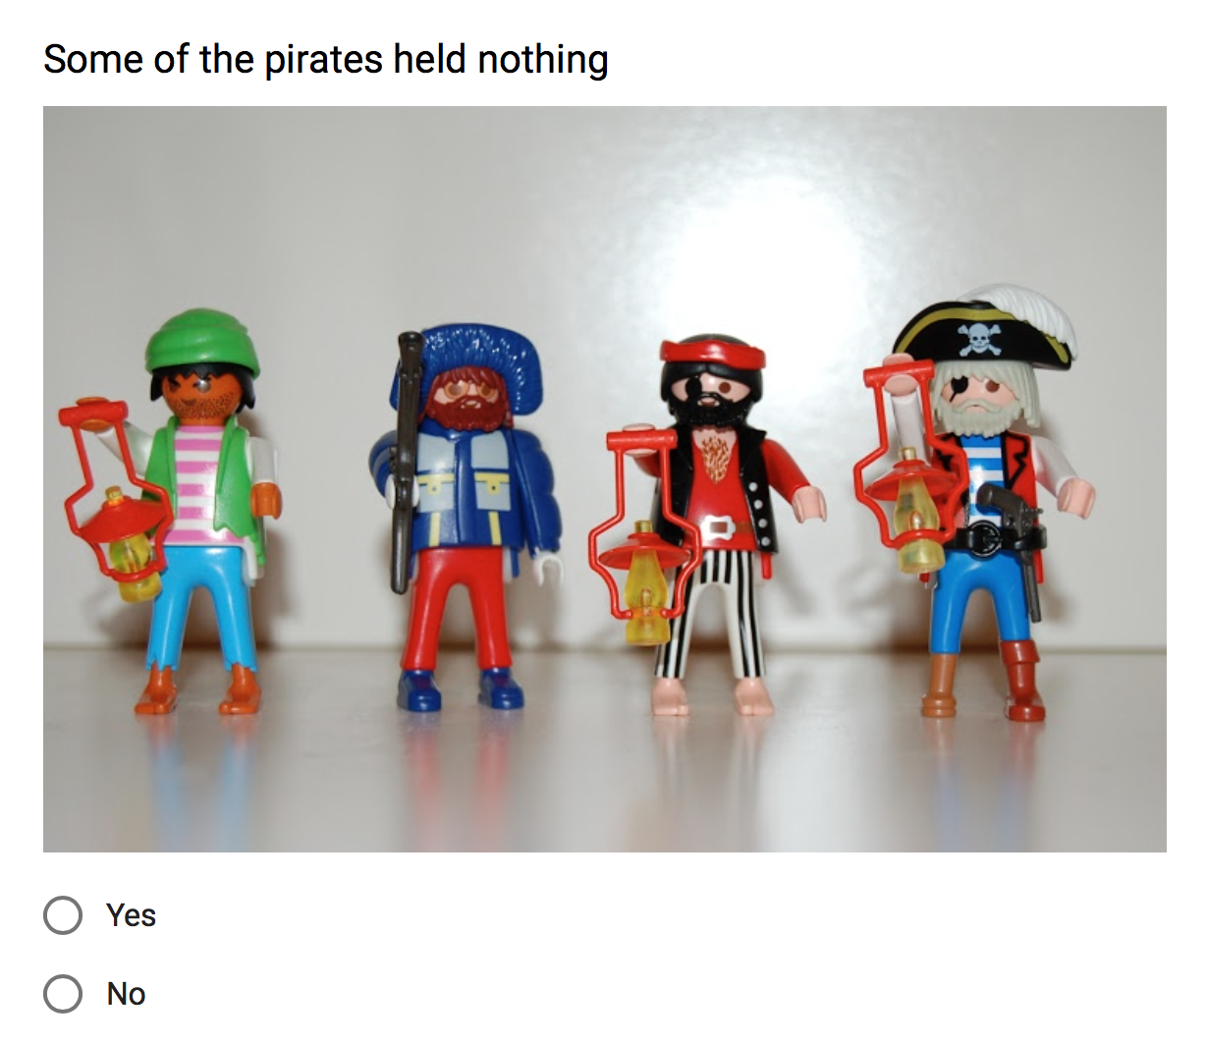
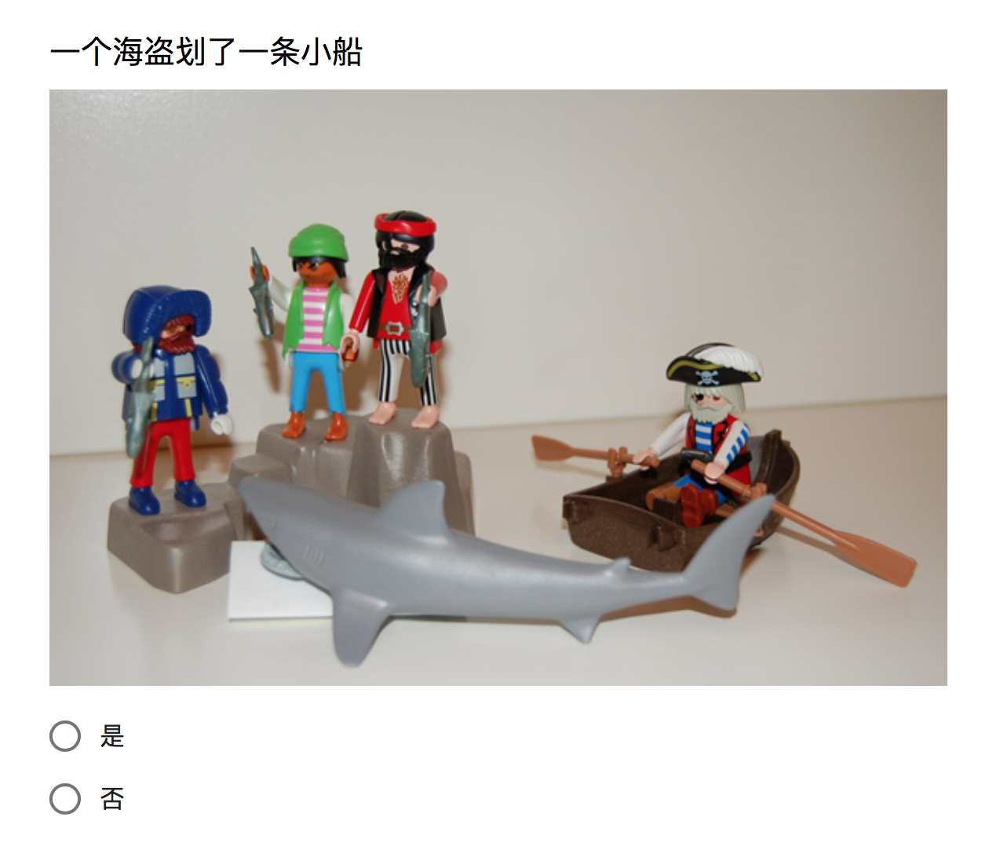
Methodology
Three types of statement are provided in the survey - No ambiguity (constant)
English - (Native English Speaker )
Chinese - (Bilingual English Speaker)

Slide 21
Methodology
Distribution of questions - Bilingual Speaker
OE - I → 6 Questions EO - I → 6 Questions OE - S → 6 Questions EO - S → 6 Questions Fours kinds of amiguity sitaution are evaluated Neutural (No ambiguity) → 20 Questions ; → ~ 50% of total questions Serve as a filler → Avoid participants trying to guess the ‘right answer’ → Make the result more objective
1 | OE- I | 11 | OE - I | 21 | N/A | 31 | N/A | 41 | OE - I
2 | N/A | 12 | OE - S | 22 | OE - S | 32 | N/A | 42 | EO - S
3 | N/A | 13 | EO - S | 23 | EO - I | 33 | N/A | 43 | N/A
4 | EO- I | 14 | N/A | 24 | EO - S | 34 | EO - I | 44 | N/A
5 | OE - I | 15 | EO - I | 25 | OE - I | 35 | N/A
6 | EO - I | 16 | OE - S | 26 | N/A | 36 | EO - S
7 | N/A | 17 | N/A | 27 | EO - I | 37 | N/A
8 | N/A | 18 | OE - I | 28 | EO - I | 38 | OE - S
9 | OE - S | 19 | N/A | 29 | N/A | 39 | N/A
10 | EO - S | 20 | N.A | 30 | N/A | 40 | OE - S

Slide 22
Methodology
Distribution of questions - Native English Speaker
OE - I → 3 Questions EO - I → 3 Questions OE - S → 3 Questions EO - S → 3 Questions Less question : a. No Chinese version b. Serve as a comparison Neutural (no ambiguity) → 10 Questions ; → ~ 50% of total questions Serve as a filler → Avoid participants trying to guess the ‘right answer’ → Make the result more objective
1 | OE - S | 11 | OE - S | 21 | N/A
2 | N/A | 12 | N/A | 22 | EO -S
3 | OE - I | 13 | N/A
4 | N/A | 14 | OE - S
5 | N/A | 15 | EO - I
6 | N/A | 16 | EO - I
7 | N/A | 17 | N/A
8 | OE - I | 18 | OE - I
9 | EO - S | 19 | N/A
10 | EO - I | 20 | EO - S

Slide 23
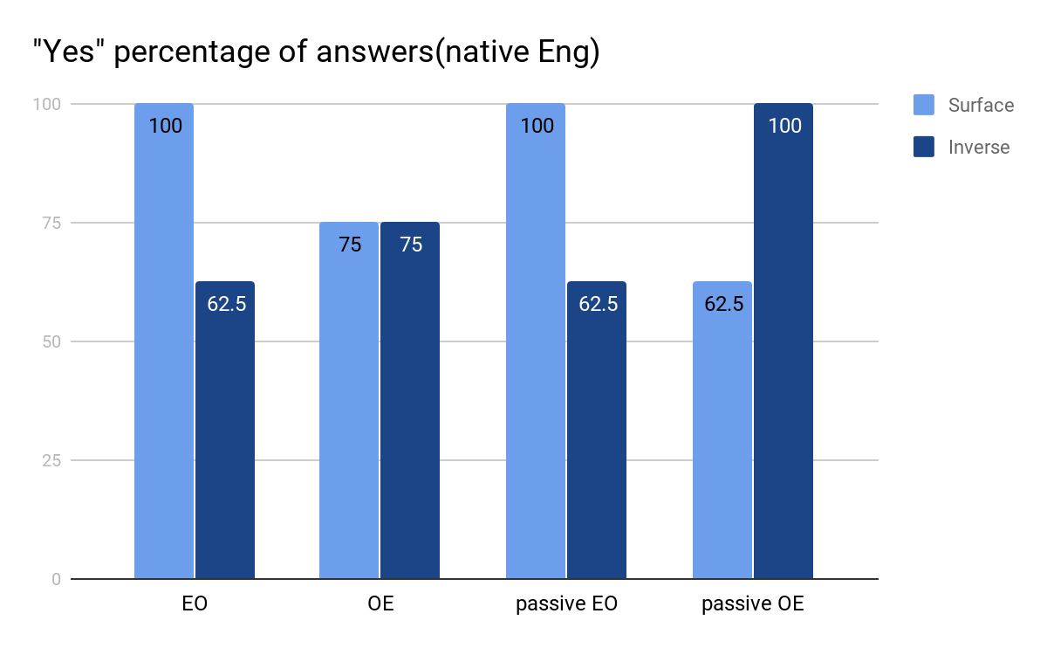
Results of English Native speakers
Completely understand EO_Sur but lower understand EO_Inv
Relative low but same OE_Sur and OE_Inv
Passive structure causes no difference to EO but make people choose more OE_Inv
In the large picture, Surface and Inverse version of both EO and OE as well as their passive structure are well-understood by English Native speakers
Notes:
English native speakers fully understand EO surface but not inverse. and both meaning of OE is high about 75%.passive structure does not change EO but make make people choose moreinverse in OE. We can say that scope ambiguity in native English is obviously exists because all of them are over 50%

Slide 24
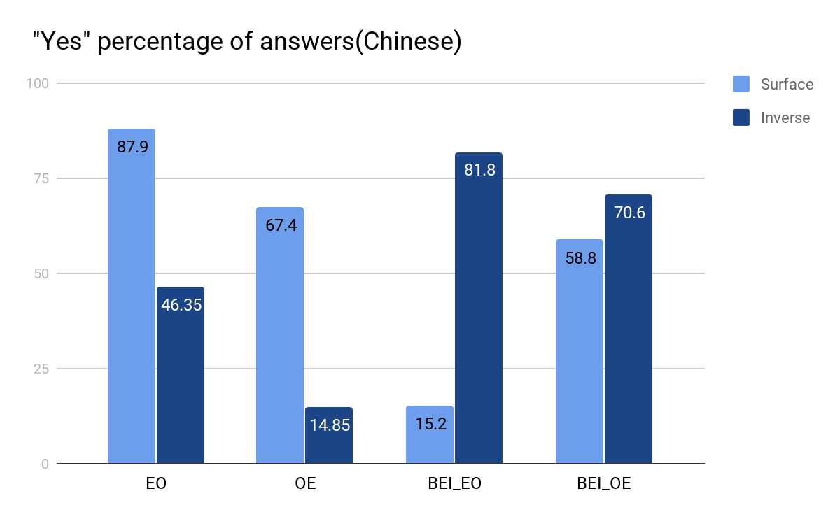
Results of Chinese Bilingual speakers(CHI)
Surface version is much higher than Inverse version in both EO and OE.
Passive structure of EO still show elimination of scope amiguity, but change to EO_Inv
Passive structure of OE show scope amibiguity.
Notes:
For Chinese part of Chinese speakers, surface meaning is much higher than inverse meaning. And only passive structure of OE show scope ambiguity.

Slide 25
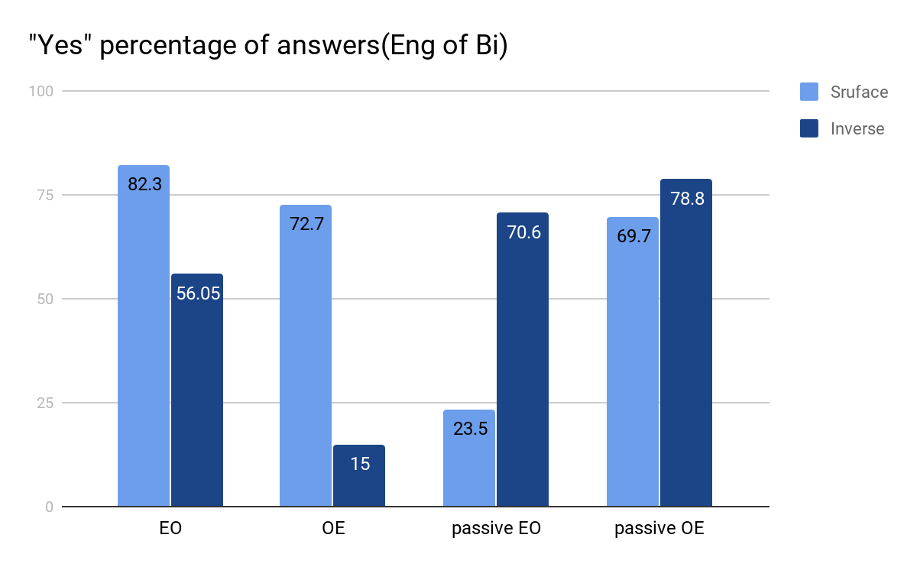
Results of Chinese Bilingual speakers(ENG)
Surface of both EO and OE is much higher than Inverse, especially OE. but ratio of EO_Inv is a little higher than our expectation
Passive structure of EO decreases scope amibiguity - people tend to choose EO_Inv
Only passive version of OE display scope amibiguity.
Notes:
For English part of bilingual speakers, it’s relative same as Chinese one, but inverse of EO is little higher than our expectation. also only passive structure of OE show scope ambiguity.

Slide 26
English and Chinese native speakers have very different understanding of scope ambiguity in their own language.
Understanding of scope ambiguity in English of Chinese bilingual speakers shows very different results compared with native English.
However, English of Chinese native speakers shows a relative same distribution with Chinese.
Big difference between OE_Sur and OE_Inv.
Opposite result of passive sturcture of EO compared to native English graph.
Relative small difference between passive OE_Sur and passive OE_Inv.
------> For scope ambiguity understanding, English of bilingual Chinese speakers is deeply influenced by their native language(Chinese)
Notes:
Now we put three graphs together. We can see that, for OE, Surface meaning is much higher than Inverse meaning in English of bilingual speakers, which is same as Chinese but not native English, and also, only passive structure of OE show scope ambiguity in Chinese and English of Bilingual speakers but not native English. we can say that English of bilingual speakers is deeply influenced by their native Chinese.

Slide 27
Results Summary
Hypothesis 1 : Chinese has small scope ambiguity (Inverse version will not be allowed). English has large scope ambiguity.
----YES! though Inverse can still be accessed in Chinese, it does have small scope ambiguity.
Hypothesis 2: Passive structure will not change understanding of native English speakers, but it will enlarge the scope ambiguity in both Chinese and English of native Chinese speakers
---- Half right. In native English, passive structure decrease the scope ambiguity of OE. In Chinese and English of bilingual speakers, only the scope ambiguity of passive OE is enlarged.
Hypothesis 3: English of native Chinese speakers will not be same as that of native English, it will be relatively same as their native language——Chinese.
---- YES!

Slide 28
Questions and Possible reasons
Why Inverse version in EO is relatively higher than our expectation in Chinese and English of Chinese native speakers ?
Reason: Inverse meaning actually entail Surface meaning in EO. For example, Every shark attacked a pirate. If there is a single pirate that every shark attacked, then it’s necessarily true that Every shark attacked a pirate. So OE is better for proving whether there is scope ambiguity without entailment problem.
2. Why enlarging effect of passive structure only works in OE?
Reason: passive EO begins with “有一条/个” such as “有一条鱼被每一条鲨鱼抓住了”. And “有一条/个” may restrict the meaning to “a certain one/a single one” then EO_I is much higher than EO_S. Passive OE such as “每一条鱼都被一条鲨鱼抓住了” does not have this problem.

Slide 29
Interview Reports
Mandarin speakers report:
The feeling of confusion
Some questions seem to appear twice
These response are in contrast with our expectation: Given to that Chinese speakers are not aware of the scope ambiguity of double-quantifier sentences
Chinese speakers should not feel too confused about the sentences
They judge inverse readings to be odd without hesitation

Slide 30
Hypothesis of The Confusion
Chinese speakers’ confusion is caused by the clues provided in the pictures.
Stimulus control and overshadowing (Pavlov 1927): when two stimuli are presented at the same time, the presence of the more easily trained stimulus may hinder learning about the other one.
Pictures can overshadow words (Wendt 1956).
Therefore, participants in this experiment
First analyze the picture and process the information it provides.
Then they judge if the sentence has the possibility to match such meaning.

Slide 31
Scope Ambiguity in Chinese
Relative clause (scope ambiguity) (3>every, every>3)
Wo jian-guo [jiang mei-zhong yuyan de san-ge xuesheng].
I meet-ASP speak every-CL language DE three-CL student
‘I have met three students who speak every language.’
Simple sentence (no scope ambiguity) (3>every, *every>3)
San-ge xuesheng jiang mei-zhong yuyan.
three-CL student speak every-CL language
‘Three students speak every language. ’ (WU, Liu, Liu, & Larson, 2017)
Therefore, with the cue given by the pictures, participants are likely to see the possibility of the inverse reading.
Maybe another cause of the high percentage of the agreement on inverse readings.
Could be supported by a report from our participant. She reports to describe the pictures, that is, positively accepts what the pictures describe as true and test the possibility of the sentence describing it.

Slide 32
Solution 1
A pervious experiment conducted in Harvard uses a different grading method from us:
Instead of using a simple yes or no question, researchers use a 7-point Likert scale (1 = completely inappropriate, 7 = completely appropriate)
This method may solve the problem mentioned above:
Participants have the space to feel “a little agree” and “a little disagree”, and thus can reveal their likelihood of the structures more accurately

Slide 33
Problem in Solution 1 And Solution 2
This method is better than the one that is use by us, but it still has some problem:
Some people may feel uncomfortable to choose the strongest and the weakest choices.
For example, even though participants feel EO-S sentences are appropriate, still they will choose 6 instead of 7
May have significant influence on the result of inverse readings.
Improved solution based on solution 1: show the sentence first, followed by the picture after a short period of waiting time.
This may help subjects to form a understanding of the sentence without being influenced by the picture.

Slide 34
A Sepcial Case
The only one participant who studys in America
Directly pointed out that a double-quantifier Chinese sentence should have two possible readings: surface and inverse.
Felt surprised when informed that in Chinese scope ambiguity reading is not allowed.
While for other subjects, despite them may feel confused, they are not aware what causes the confusion.

Slide 35
Hypothesis of The Special Case
English has effects on Chinese. Long-time exposing to English environment causes the acceptance of scope ambiguity in Chinese.
However, this hypothesis has been proved to be false by previous researches: heritage Chinese speakers showed the prohibition of inverse reading in both Chinese and English. (Scontras, Tsai, Mai & Polinsky, 2014)
Processing Scope Economy principle (Anderson, 2004): Speakers tend to adopt the simpler grammar and surface structures.
English speakers are more likely to choose surface readings, and when a simpler grammar system (Chinese) is available, speakers will adopt it, even if it is not their domain language.

Slide 36
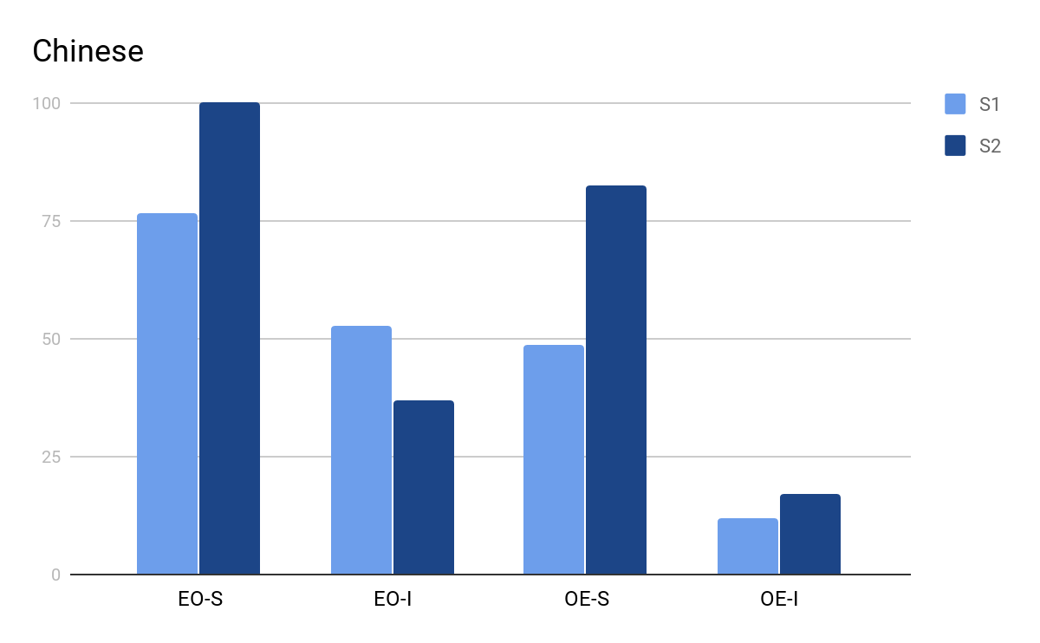
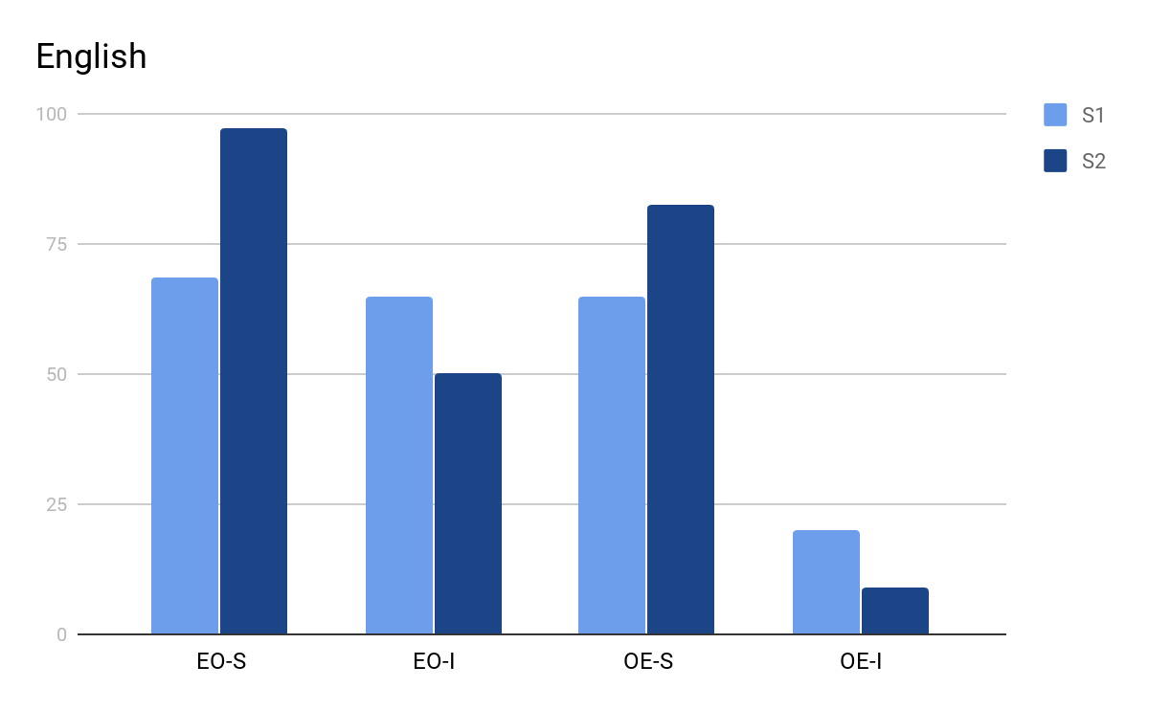
Other Issues Without Explanation
One pair of sentences has significantly deviation from the expected result: the sentences involves sharks and pirates. (S1 Every shark attacked a pirate/A s. attacked every p.) (S2 Every p. held a bottle/A p. held every b.)
Hypothesis: the properties of nouns involved have some influence on the scope ambiguity.

Slide 37
Conclusion
Our experiment is based on an paper published at 2014. Both English native speakers and Chinese-English bilingual speakers are involved. (Scontras, Tsai, Mai & Polinsky, 2014)
Our main hypothesis is Chinese does not allow scope ambiguity and this property of Chinese will transfer to Chinese native speakers’ second language (English).
Our results are generally consist with the hypothesis, but there are other issues that require our attention.

Slide 38
References
Kearns, K. (2011). Semantics.
What Are the Main Types of Ambiguity? (n.d.). Flax interactive language learning. Retrieved April 23, 2018, from http://flax.nzdl.org/greenstone3/flax;jsessionid=052401C6323F0CF2209B8A03DDD5FA55?a=d&c=BAWEAH&d=D2526&dt=simple&p.a=b&p.s=ClassifierBrowse.
Kurtzman, H. S., & MacDonald, M. C. (1993). Resolution of quantifier scope ambiguities. Cognition, 48, 243-279. Retrieved April 23, 2018, from http://citeseerx.ist.psu.edu/viewdoc/download?doi=10.1.1.460.4104&rep=rep1&type=pdf
Scontras, G., Tsai, C. E., Mai, K., & Polinsky, M. (2014). Revisiting inverse scope: An experimental study of Chinese and English. Retrieved April 23, 2018, from https://scholar.harvard.edu/files/mpolinsky/files/chinese_scope_sub.pdf.
Scontras, G., Tsai, C. E., Mai, K., & Polinsky, M. (2017). Cross-linguistic scope ambiguity: When two systems meet. Glossa: a journal of general linguistics, 2(1), 1-28. Retrieved April 23, 2018, from https://doi.org/10.5334/gjgl.198

Slide 39
References
Wu, H. C., Liu, L., Liu, Y. B., & Larson, R. (2017). Rethingking quantifier scope in Mandarin. Retrieved April 23, 2018, from http://iceland2017.nelsconference.org/wp-content/uploads/2017/08/Larson-Wu-Liu-Liu-Mar.pdf
Anderson, C. (2004). The structure and real-time comprehension of quantifier scope ambiguity.
Pavlov, I. P. (1927). Conditioned reflexe.
Wendt, P. R. (1956). The language of pictures. ETC: a review of general semantics, 13, 281-288. Retrieved April 23, 2018, from http://www.jstor.org/stable/42581627?read-now=1&seq=1#page_scan_tab_contents

Slide 40
Q&A

Slide 41
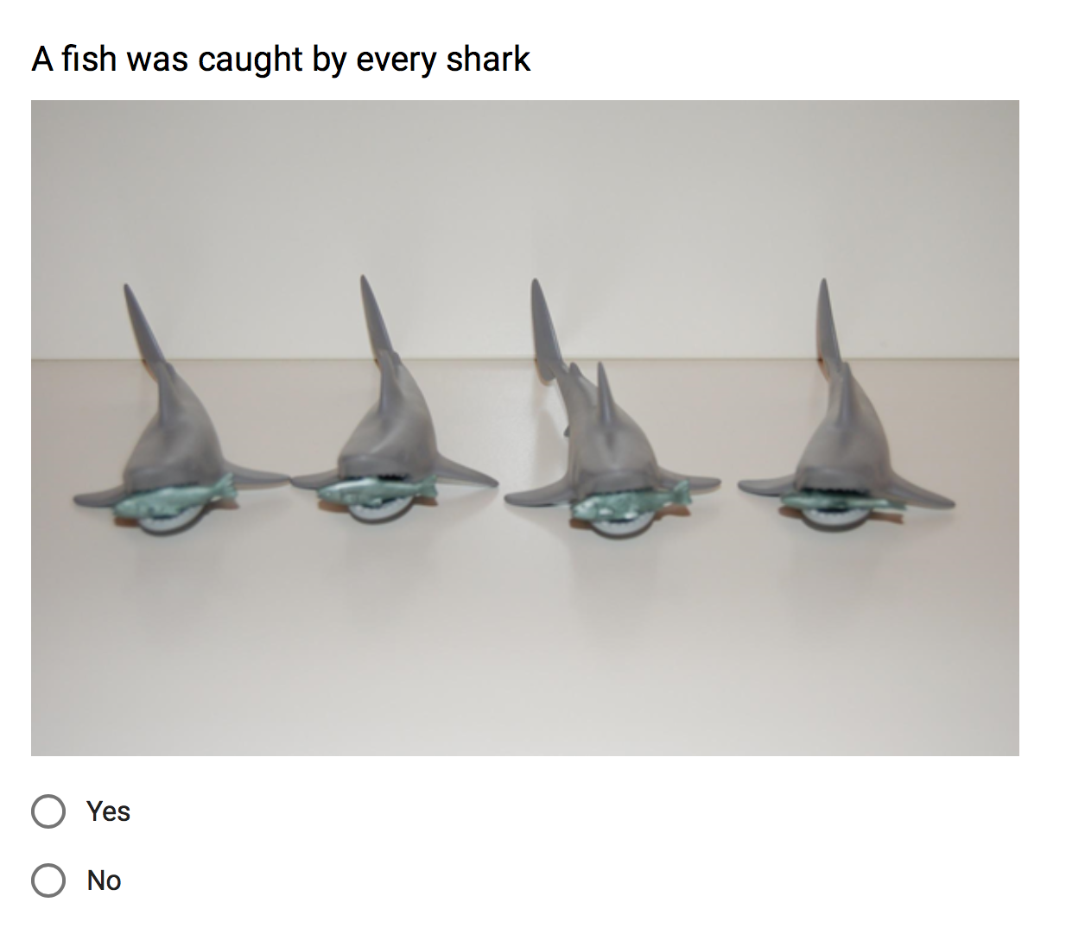

Methodology
Three types of statement are provided in the survey - Surface meaning
Native English Speaker - OE - Surface
Bilingual English Speaker- EO - Surface
Bilingual English Speaker - EO - Surface (Chinese)

Slide 42
Methodology
Three types of statement are provided in the survey - Inverse Meaning
Native English Speaker - OE - Inverse
Bilingual English Speaker- EO - Inverse
Bilingual English Speaker- EO - Inverse (Chinese)

